Slide 1
Asian Online Nations Cup
Technical Meeting – 9 October 2020

Slide 2
Tournament Overview
List of teams is published in chess-results.com under UAE.
Games will be played on Chess.com. Be sure your players are logged https://www.chess.com/live. If they are not in /live they cannot be paired.
Players should log into Zoom with real names prefixed by country code and board number, e.g. “IND1 Viswanathan Anand”. They will be assigned to breakout rooms. Arbiters will write Arbiter before their name.
Notes:
1

Slide 3
Tournament Spirit
The tournament is organised as a replacement for the 2020 Asian Nations Cup due to the ongoing pandemic
The tournament provides an opportunity for players to play in something as similar as possible
Arbiters have been informed to be as helpful as possible, and help players and captains to avoid sanctions, or missing deadlines for team submission etc.
Our overriding principle will be to arrange for as many games of chess to be played as possible
Co-operation from captains is important in helping us to achieve this

Slide 4
Tournament Schedule
Friday Technical Meeting 9 Oct. 10am (UAE time GMT +4)
Saturday 10 Oct, 9am Zoom, 10am Men Rd1, 11am Men Rd 2, 12nn Men Rd3
Sunday 11 Oct, 9am Zoom, 10am Women Rd1, 11am Women Rd2, 12nn Women Rd3
Friday 16 Oct. 9am Zoom, 10am Men Rd4, 11am Men Rd 5, 12nn Men Rd6
Saturday 17 Oct. 9am Zoom, 10am Women Rd4, 11am Women Rd5, 12nn Women Rd6
Sunday 18 Oct. 9am Zoom, 10am Men Rd7, 11am Men Rd8, 12nn Men Rd9
Monday 19 Oct. 9am Zoom, 10am Women Rd7, 11am Women Rd8, 12nn Women Rd9
Friday 23 Oct. 9am Zoom, 10am QF (M&W), 11am QF (M&W)
Saturday 24 Oct. 9am Zoom, 10am SF (M&W), 11am SF (M&W)
Sunday 25 Oct. 9am Zoom, 10am Finals (M&W), 11am Finals (M&W)

Slide 5
Tournament System
Preliminaries 9-round Swiss System
Pairings will be made by Swiss Manager, top seed is white rd 1 bd1
Individual Board Medals calculated from Swiss System Preliminaries Only
Top 8 teams qualify to knockout stage
Pairings and colors are defined. Team on left is white bd1, match 1
Quarterfinals: Duel of 2 Matches (reverse colors on bd1)
Duel I: 1 vs 8, Duel II: 7 vs 2, Duel III: 3 vs. 6, Duel IV: 5 vs. 4
Semifinals: Duel V: Winner of Duel I vs. Winner of Duel IV;
Duel VI: Winner of Duel III vs. Winner of Duel II
Finals: Duel VII: Winner of Duel V vs. Winner of Duel VI

Slide 6
Arbiters
Chief Arbiter IA/IO Abdulrahim Mahdi (UAE)
Tournament Director/Pairings IA Mehrdad Pahlevanzadeh (IRI)
Deputy Chief Arbiter (Men) IA Haroon or Rashid (BAN)
Deputy Chief Arbiter (Women) IA K.K. Chan (HKG)
Zoom Arbiters:
Room 1: Al-Takrori, Husam (PLE) Room 8: IA Patrick Lee (PHI)
Room 2: IA Al Wadhahi Musallam (OMA) Room 9: IA Abd Hamid Majid (MAS)
Room 3: IA Ibrahim, Yousef Khalil Room 10: IA Kausar Bauyrzhan (KAZ)
Room 4: Razan Al Shoaibi (JOR) Room 11: IA Irina Semenova (UZB)
Room 5: IA Azizi, Khatereh (IRI) Room 12: IA Shaun Press (PNG)
Room 6: IA Niranjan Prajapati (NEP) Room 13: IA Gibbons, Robert (NZL)
Room 7: IA Sainbayar, Tserendorj (MGL)

Slide 7
Technical Delegate
Casto Abundo (PHI)
Appeals Committee:
Chairman: Bharat Singh (IND)
Member: Paul Spiller (NZL)
Member: Husan Turdialiev (UZB)
1st Reserve: Dhafer Al Madhloum (IRQ)
2nd Reserve: Dang Tat Thang (VIE)

Slide 8
Regulations
You have already received:
Regulations
Technical Information
Setup Information
Other Information
List of Team Composition and Chess.com user names
List of Breakout Rooms and links to Chess.com clubs
It is mandatory that your players join their respective clubs.
Arbiters check in clubs if players are on /live.

Slide 9
Technical Information - Summary
Modern computer required (no tablets or phones)
Summary of the checks:
Webcam
Microphone
Speakers
The playing area should be cleared of all non-essential electronic items

Slide 10
Technical Information - Summary
Must arrive in the Zoom call at least 1 hour to 30 minutes before start
You will be moved into the correct Breakout Room within Zoom by the arbiters
You will be expected to share your screen
Youw will be required to open Task Manager
Players may not communicate at all with their teammates or captain during play
If you have a technical issue please directly contact the arbiter
Arbiters may contact players directly by chat or call – this must be replied to immediately

Slide 11
Technical Information - Summary
Chess.com Fair Play measures will be in force
Players will receive notice and warning by chat for various infractions

Slide 12
Setup Information - Summary
Checks to be made to your players’ Chess.com:
Real name (as it appears on the FIDE rating server); i.e. with First Name and Surname
Correct flag for your country
Make sure your Zoom profile has the three-letter code for your Federation (e.g. BHU, FIJ, PAK)
Random checks of programs (Task Manager) for the players
Games may be delayed until these things are done – it is important to be correct for the broadcast.

Slide 13
Other Information - Summary
Be aware of the various positions that are automatically declared drawn by the server (note: the next slide)
50 move rule and 3-fold repetition rule automatically enforced
Captains may not be involved with draw offers

Slide 14
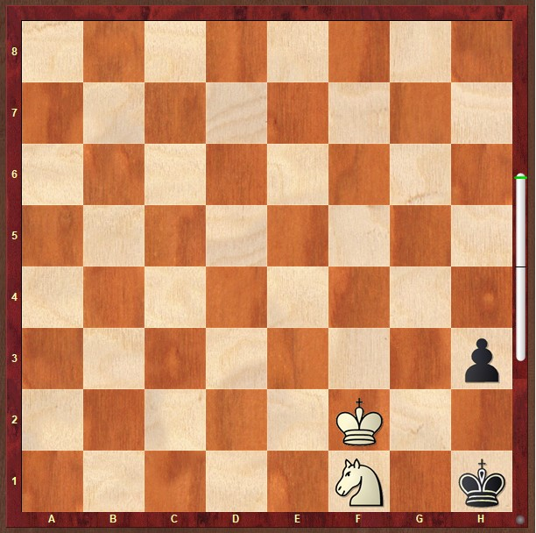
Overriding Chess.com results
In general, the result prescribed by Chess.com will stand (see the set list of drawn positions).
However, there are positions such as the one in the diagram. With black to play in this position, it is checkmate after h2, then Ng3 for white.
With black to play, if black lets his or her time expire, then the Chess.com server will automatically call this a draw.
In the unlikely situation that this or a similar position happens, players may appeal to an Appeals Panel and appeal that they should be declared the winner of the game.

Slide 15
Miscellaneous Information

Slide 16
Team Submission
Team line-up must be submitted at least 10 minutes before the scheduled start time of the next round
We will constantly remind you about this!
Please check that your password for Chess-Results works
Make sure your board order is legal, i.e. you have chosen the right number of players for the team on the right boards
At the scheduled start time, the Chief Arbiter will announce start of the games. Your players just need to be logged in and waiting at chess.com/live
Games will start around 2 minutes after publication of pairings
Do not play other games while you’re waiting for the game.

Slide 17
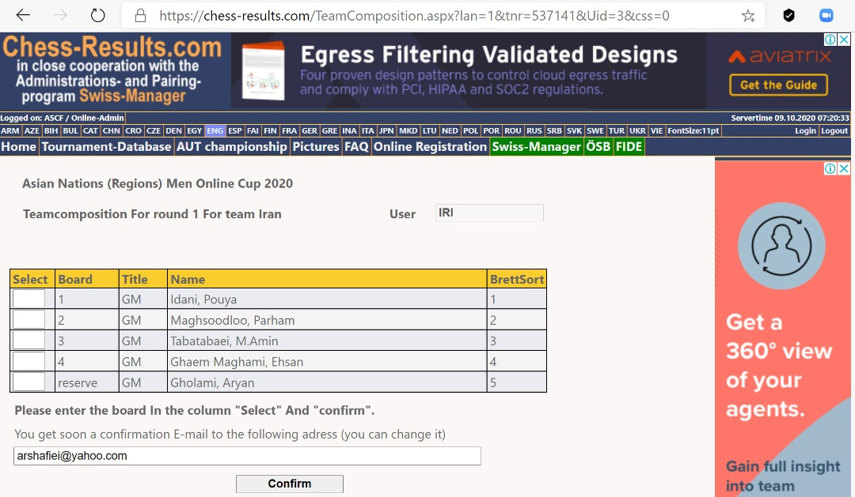
Team Submission Example Passwords have been sent to all team captains. Please test and practice submiting line-up for first round. You may contact Tournament Director Mehrdad Pahlevanzadeh for assistance.

Slide 18
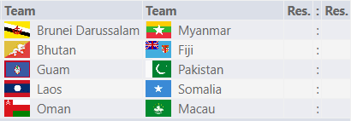
Color
The team on the left-hand side is white on boards 1 and 3.
The team on the right-hand side is white on boards 2 and 4.

Slide 19
Disconnection of Matches
“Our overriding principle will be to arrange for as many games of chess to be played as possible”
Before the start of the game Arbiters will check your internet connection to Chess.com.
Asian Chess Federation or Chess.com have no responsibility for technical problems arising for players during the games.
In case it is a Chess.com server problem we can try to resume games from the position reached.

Slide 20
Disconnections
A player who disconnects will always be able to get their connection back until their time would expire
Things to look for:
Making a move but your own time still runs
Trying to make a move but the computer won’t let you
Tips:
Refreshing the browser
Have a spare Internet connection accessible

Slide 21
Tie Break
Preliminaries:
Match Points
Game Points
Direct Encounter Match Points
Direct Encounter Game Points
Sonnenborn Berger (Match Points)
Sonnenborn Berger (Game Points)
Board Count (Berlin System)
Blitz Match
Board Count of Blitz Match
Individual Armageddon
Quarterfinals, Semifinals, Finals
Match Points
Game Points
Board Count (Berlin System) of 2 Matches
Blitz Match
Board Count of Blitz Match
Individual Armageddon

Slide 22
Individual Board Awards Players assigned to the same board number in their respective team lists shall be in competition for individual board prizes namely: gold, silver and bronze certificates. For the purposes of this award, the players’ performance rating in the Preliminaries shall be compared. If the performance rating is equal, the tie shall be broken in the following order: (a) the number of games (more is better); (b) Direct Encounter; (c) average rating of opponents, higher is better. (d) the greater number of wins. Only players who have played a minimum of 6 games shall be eligible for board prizes on boards 1 to 4 and 5 games for board 5.

